Slide 1

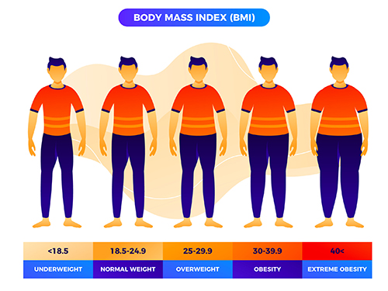
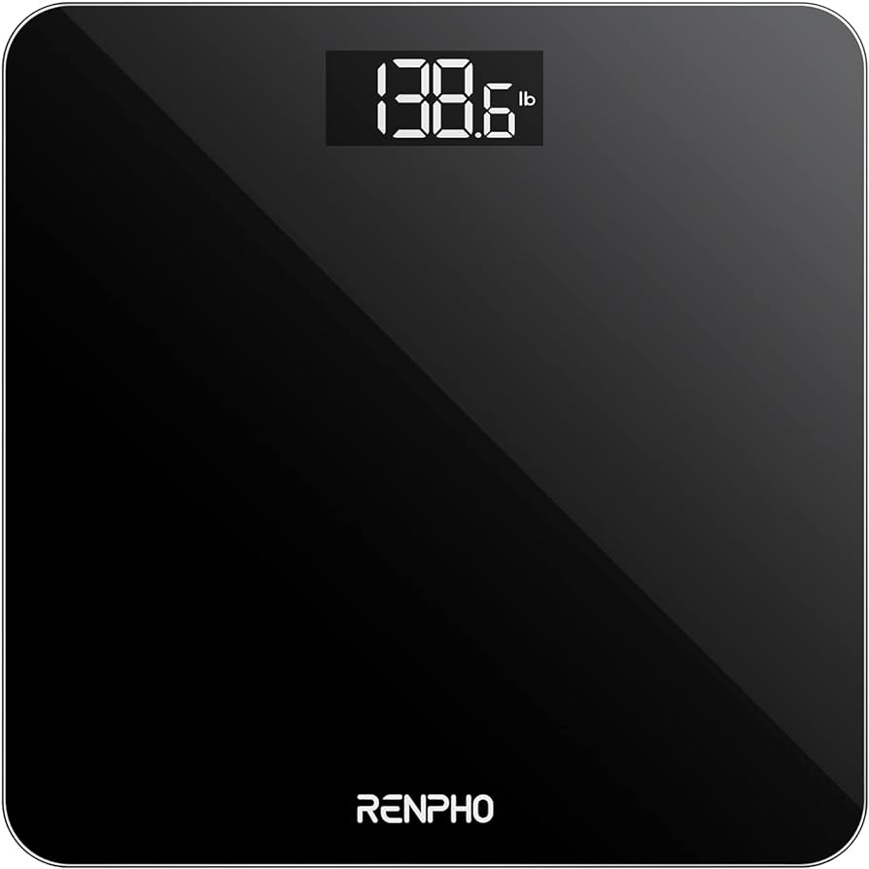
The Obesity Problem in the World and How Weight Loss Applications can Help
CIS129 - Final Project
By: Christopher Kiernan

Slide 2
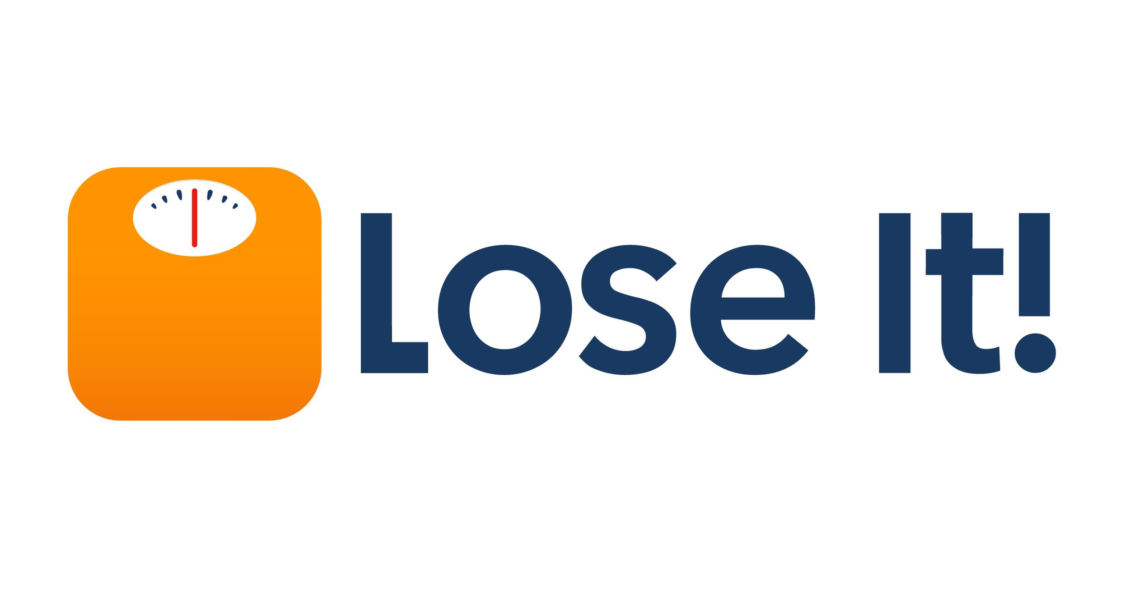


Weight Loss Applications
Application that exist currently for weight loss include the LoseIt! Application, WeightWatchers,and MyFitnessPal.
The applications exist to help track caloric and nutritional information for the user.

Slide 3

How These Applications have Tangible Impacts on our Lives
From my personal experience using weight loss applications to track my caloric intake, I noticed key details that these applications have implemented in order to keep the retention towards the app high.
This retention is important because the number one way to keep to healthy habits is to become consistent with them. In order to stay consistent, we have to have motivation to continue towards our goal.
Easy ways to track details such as caloric intake and other nutritional values are important to maintaining a healthy BMI.

Slide 4
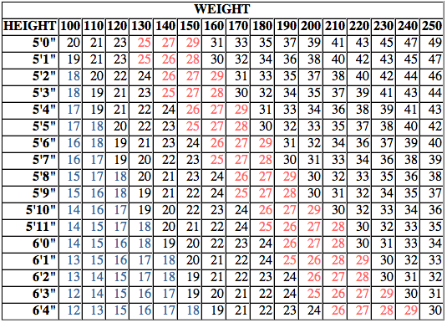
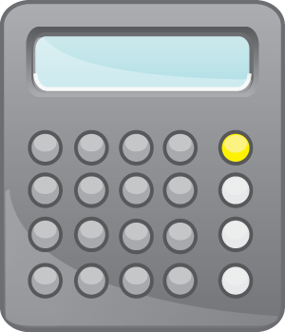
What is BMI and How is it Used?
BMI, or Body Mass Index, is the calculation used to give a general diagnosis of how much your body is storing fat. The number should be considered with other health factors like blood pressure and muscle mass since BMI is typically just a rough estimate on body fat content relative to your weight and height.
In Adults, a BMI score of 25-29.9 classifies you as being overweight while a BMI score of 30+ places you into the obesity classification.
According to the World Health Organization as of 2022, 43% of adults aged 18 and older were overweight and 16% of adults are living with obesity. These numbers have extend to children too. 37 million children under the age of 5 are considered overweight while 390 million children aged between 5-19 are overweight.

Slide 5


Monetary Issues in Regards to Weight Loss
Even though applications such as LoseIt! Are free applications, they have many features such as bar-code scanning and dietary advice locked behind their paywall. For low income families, these paywalls are affordable even if they could potentially save someone's life.
However, by putting off any type of weight management, the risks of higher medical bills in the future go up. If someone's weight gets to high levels, they could have the need for surgeries such as bariatric surgery along with the need for therapy to overcome any mental blocks preventing progress. In the United States, health insurance companies limit their coverage of these treatments until the last possible moment in order to prevent unnecessary surgeries and to keep their own profits high, so it is incredibly important to maintain healthy habits.
In some cases, such as patients with congenital heart disease, their conditions may not even be recognized by physicians or the companies behind your health insurance. In these cases, the patient will be denied the coverage they need, despite it being completely justified.

Slide 6

My Personal Experience Using a Weight Loss Application
Starting in November of 2023, I downloaded and kept track of my calorie intake through the LoseIt! App. I have managed to lose 100lbs of weight over the year of using it thanks to developing health habits and the ease of use the application provided me.
While I am in a good enough monetary and health situation that won't financially bankrupt me, it is still important that I take the necessary precautions to possibly prevent any unwanted diseases and pains I might develop in the future.
Being able to keep my attention towards my weight loss and sticking to my plan was enough for me to work towards my future.

Slide 7
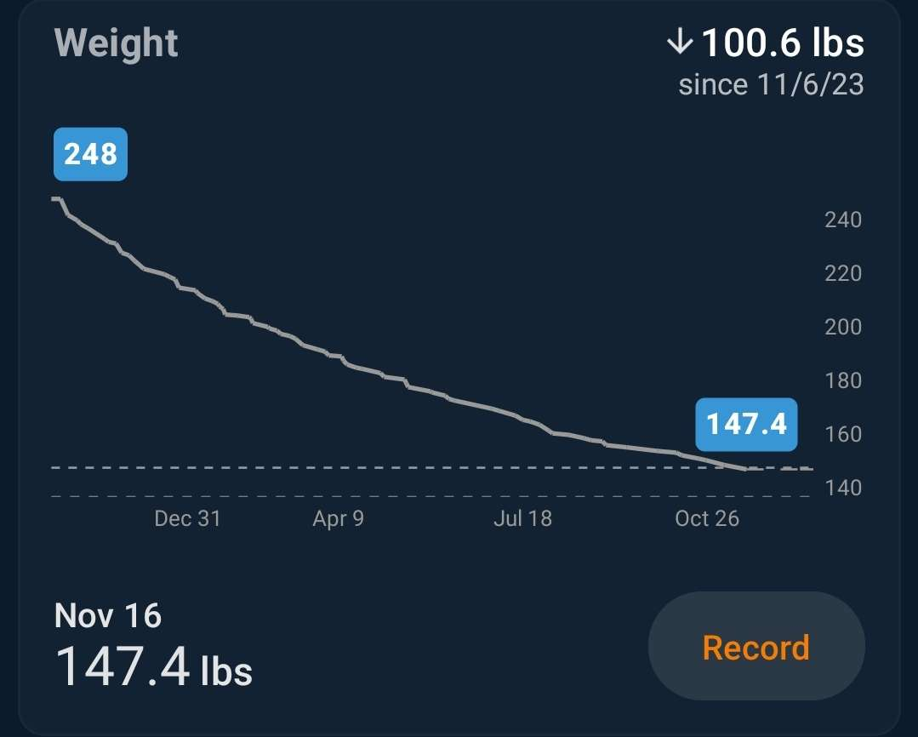
Graph of My Personal Weight Loss Journey from LoseIt! App

Slide 8
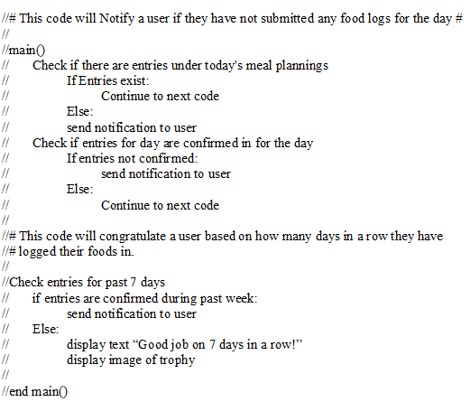
My proposed idea to keep better retention towards the applications would be to use notifications to remind the consumer to check back in with the app.
In the pseudocode, the program would check to see if the user has tracked all of the foods they had eaten during the day. If the amount of information the application has received is not sufficient enough, the application will send a notification to the user that would request for more information.

Slide 9
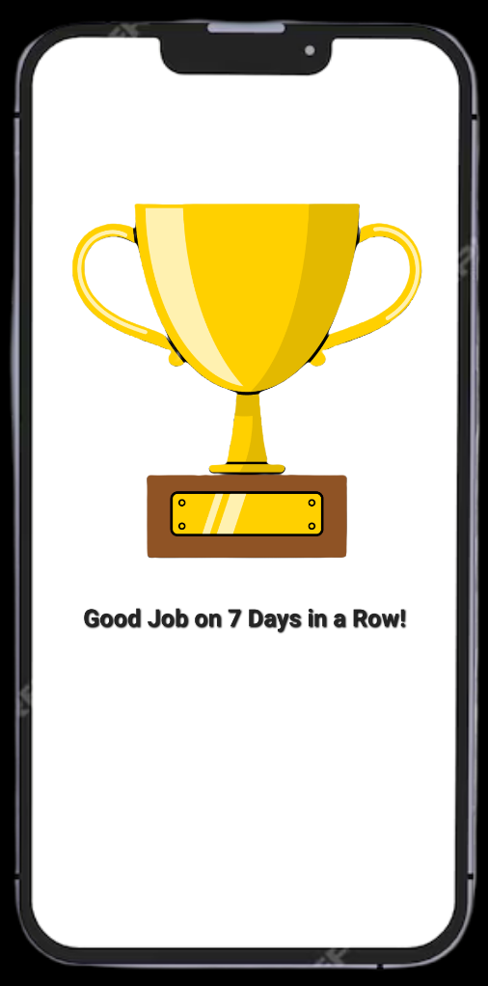
After the user has put in the information requested, the application would then run a check to see if the information has been confirmed to be accurate.
If the user has confirmed the accuracy of the information for a set period of time, the application would display a picture of a trophy and possibly keep a record of the trophy on the users profile.
This could be an incentive to the user to “collect” more trophies to see more on their profile as an accomplishment.

Slide 10


Questions that Still Remain
The biggest question I have about the topic in general is why do people who want to make this tangible improvement on their lives end up quitting the process after a short period of time? Can this be solved with one solution or is it a case-by-case situation?
Could there be a link between behavioral changes developed during a weight changing period and the motivation to continue a healthier lifestyle?
Does the restriction of convenient features, such as a bar code scanner, create a barrier of entry for users that could otherwise benefit from the app?

Slide 11

Citations
Ashtary-Larky, Damoon, et al. "Effects of Gradual Weight Loss v. Rapid Weight Loss on Body Composition and RMR: A Systematic Review and Meta-Analysis." The British journal of nutrition 124.11 (2020): 1121-32. ProQuest. Web. 13 Dec. 2024.
Houck, Philip D. "Obesity Conundrum." The American Journal of Cardiology 228 (2024): 82-4. ProQuest. Web. 15 Dec. 2024.
World Health Organization. (2024, March 1). Obesity and overweight. World Health Organization.
https://www.who.int/news-room/fact-sheets/detail/obesity-and-overweight

